Slide 1
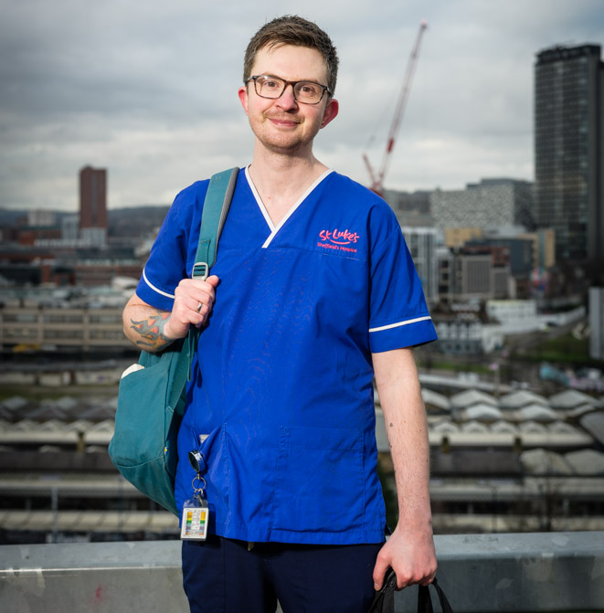

PLI September 2026
Sam Kyeremetang (Medical Director) and Hannah McLoughlin (Deputy Medical Director)

Slide 2
Agenda
Developments in Palliative and End of life Care
Themes from feedback
How to Refer into our services
Our services
Learning and Development Opportunities
Discussion around new ways of working

Slide 3

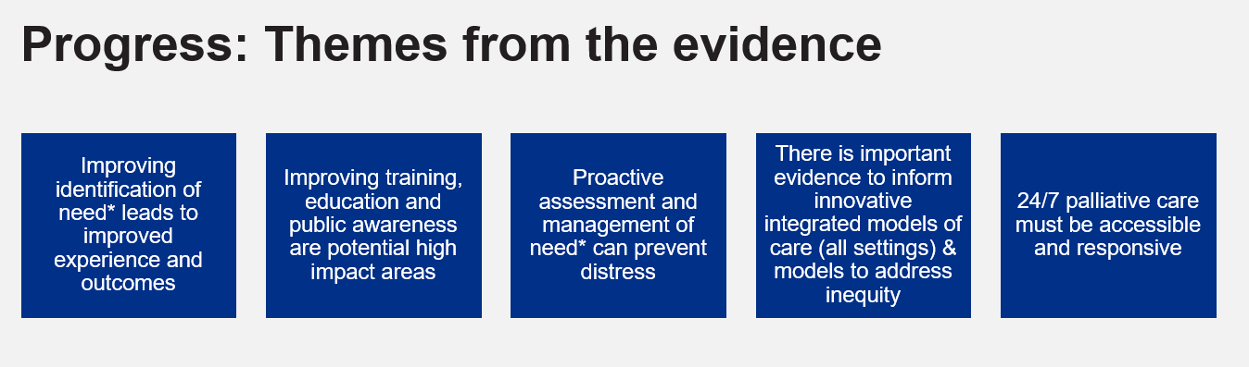
Palliative Care &End of Life Care Modern Service Framework update
Early identification, Continuity of Care, Integration, coordination and Neighbourhood health likely to feature heavily

Slide 4

Goal 1: improve health outcomes
We aim to improve health outcomes with specific focus on high-priority cohorts:
  people with frailty
  care home residents' housebound patients
  those receiving end of life care
Goal 1 objectives and metrics (compared with 2025 to 2026 baseline)
  better identify people coming to the end of life and improve access to services so people can die in a place of their choosing. By March 2029, we aim to:
  increase the number of people identified as approaching end of life by 10%
  reduce non-elective admissions and bed days of one day or over for people in the end of life cohort by 10%

Slide 5
Palliative Care and End of life care
What outcomes do you want for your patients?

Slide 6





Sheffield End of Life Intelligence Project
The Wilkes Institute

Slide 7

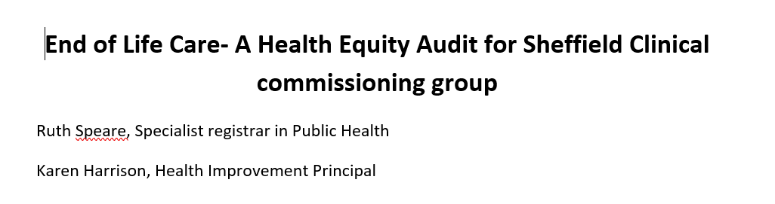
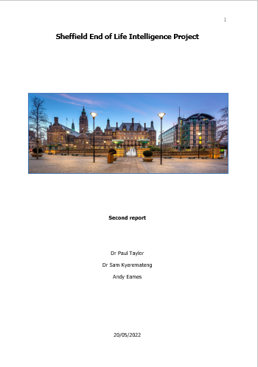
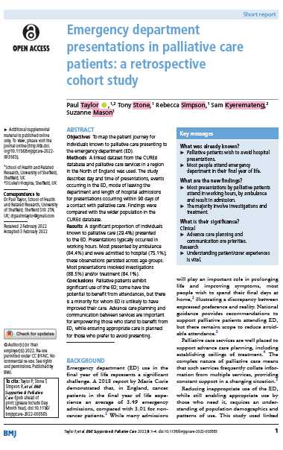
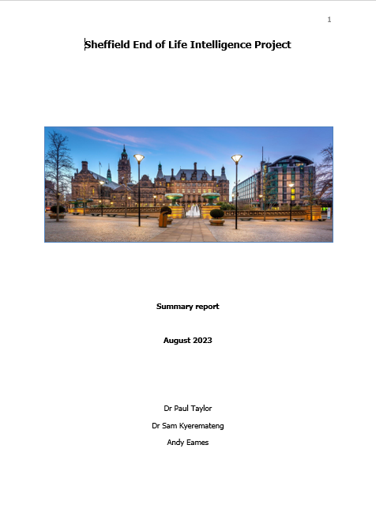
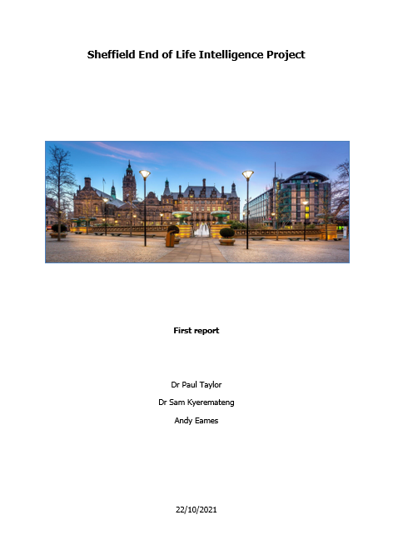
THE
WILKES
INSTITUTE

Slide 8
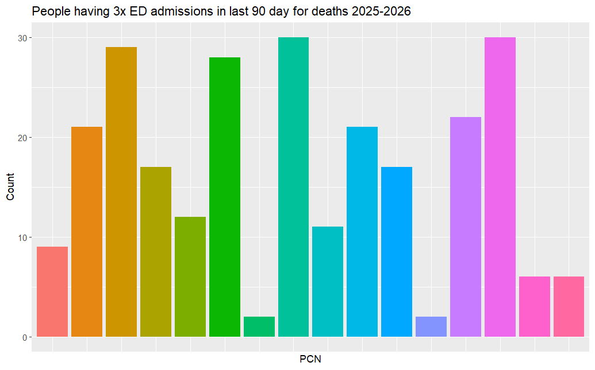
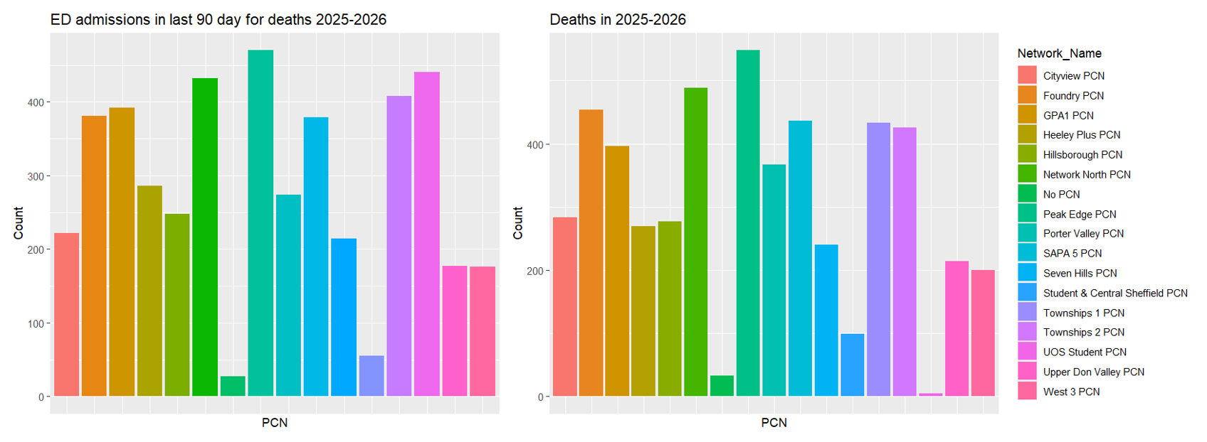
THE
WILKES
INSTITUTE

Slide 9
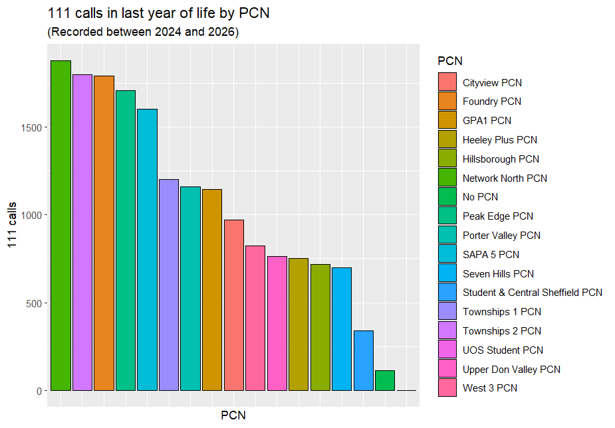
THE
WILKES
INSTITUTE

Slide 10
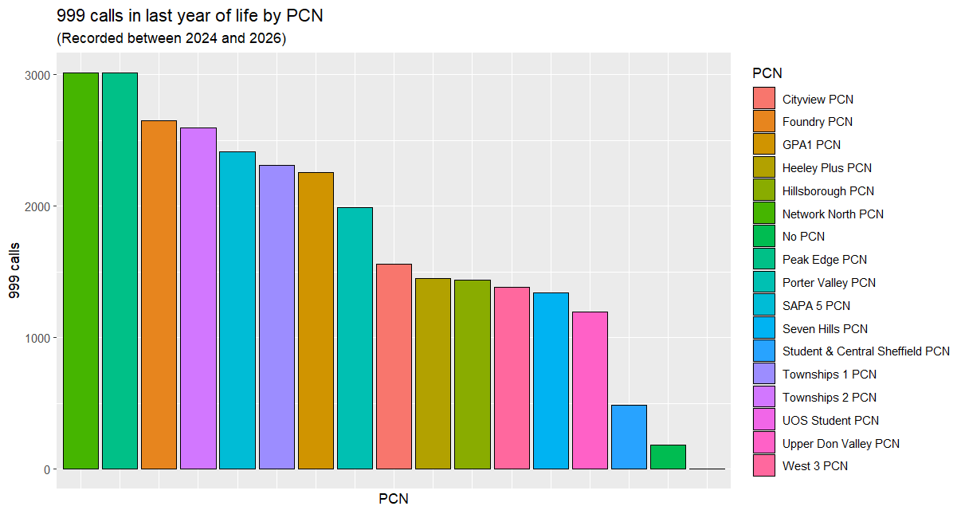
THE
WILKES
INSTITUTE

Slide 11
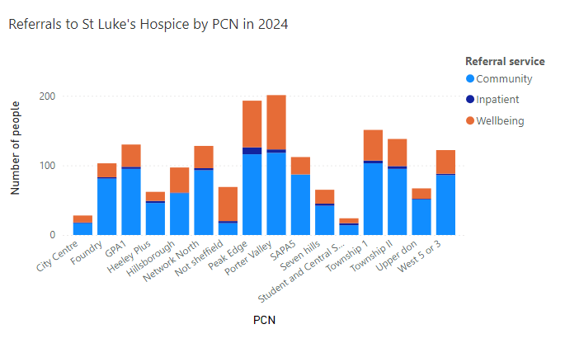
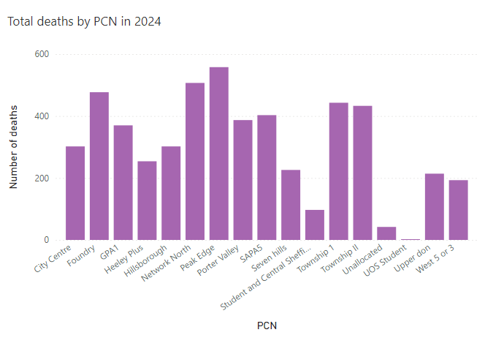
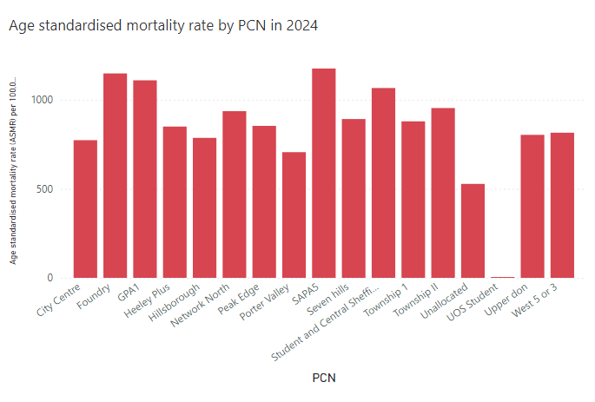
THE
WILKES
INSTITUTE

Slide 12
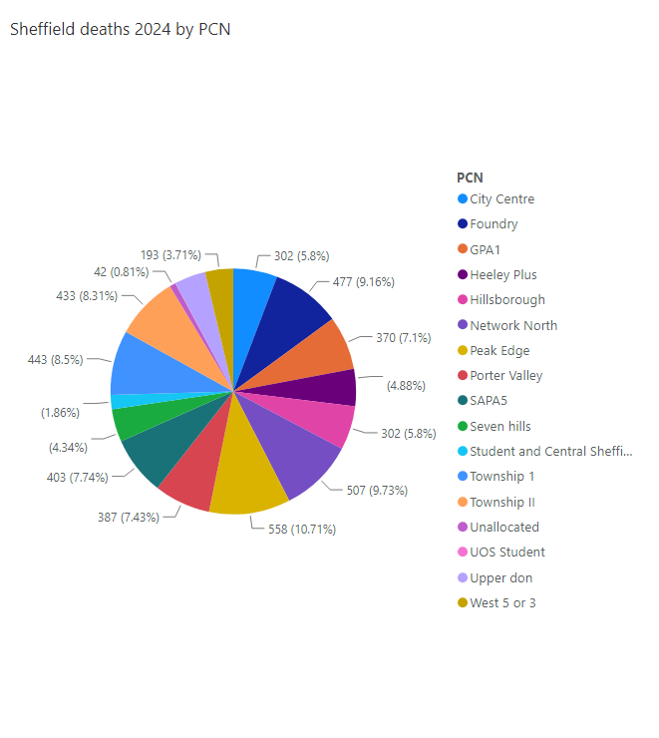
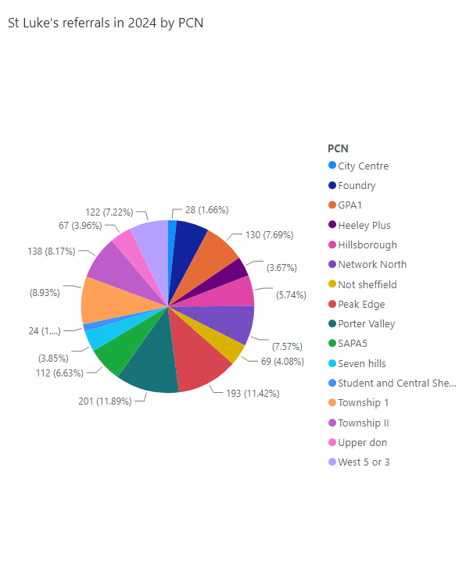
THE
WILKES
INSTITUTE

Slide 13
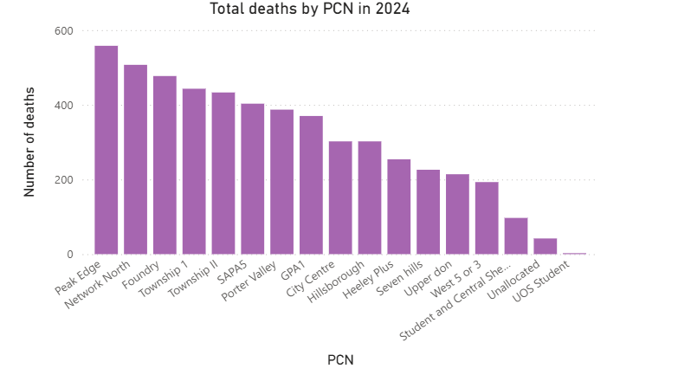
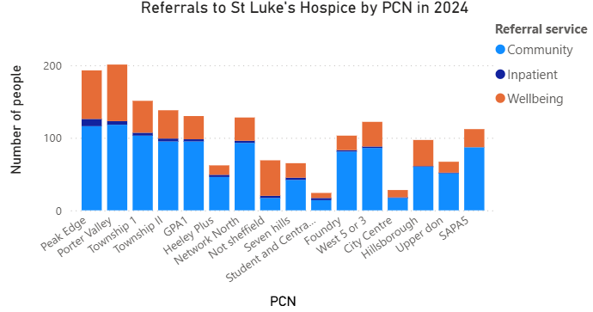
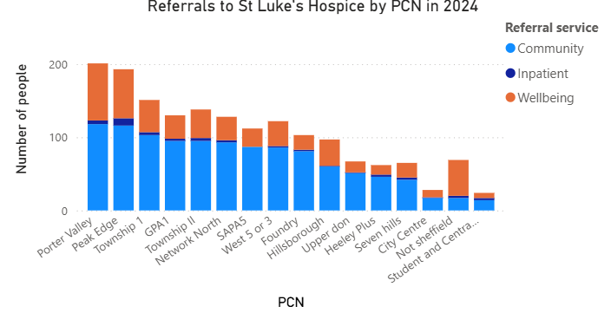
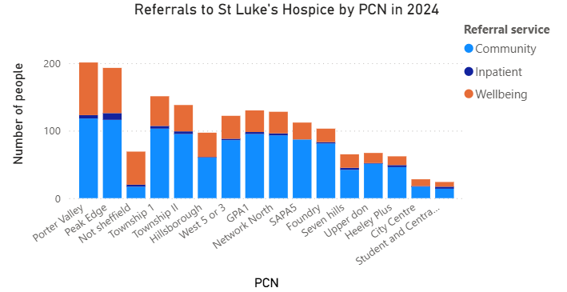
THE
WILKES
INSTITUTE

Slide 14
THE
WILKES
INSTITUTE

Slide 15
St Luke’s Hospice’s Charitable Objectives​
The company’s objectives are to relieve sickness, assist in the treatment and care of a person’s suffering from mental or physical illness of any description and in particular:​
A) By providing an establishment or establishments for sick persons where they can be given the accommodation, attendance, medical care, treatment and nursing which by reasons of their sickness that they require; ​
B) By conducting, exploring or encouraging research and the evaluation of improvements in the care of the terminally ill person. As well as that person’s carers/relatives and to disseminate the useful results of such research.​
C) By providing palliative care in the community and support for the carers and relatives of terminally ill persons. ​
Notes:
Not a huge number of replies.
? Is this a biased set of data

Slide 16
“a quiet, cosy family chaos” Dr Eric Wilkes
Independent charity
  Not linked to NHS or any other hospice
Hospice care
  Specialist palliative medicine and end of life care
  Specialist practitioners
70-75% charitable funding
Running cost of £15.5 million 2025-26
1838 people supported 2025-6, around 5000 death a year in Sheffield

Slide 17
Themes from feedback
Strong value placed on specialist palliative care support, particularly for complex symptom management, community reviews, day services, and hospice care.
Communication is the main area for improvement, with GPs preferring direct conversations, quicker advice, named contacts, and proactive phone calls rather than delayed letters.
Closer multidisciplinary working is desired, including neighbourhood meetings, virtual case discussions, and opportunities to discuss complex patients jointly.
Education remains a priority, with high interest in face-to-face teaching, Project ECHO sessions, e-learning, and case-based learning.
Awareness of services and referral pathways varies, with some GPs seeking greater clarity on available services, referral criteria, and expected response times.
Primary care capacity is a significant constraint, limiting the ability of practices to provide proactive palliative care despite commitment to delivering high-quality end-of-life care.
Notes:
Not a huge number of replies.
? Is this a biased set of data

Slide 18
How to refer and referral criteria
Inclusion criteria:
Patient is 18 years old or above.
Patient is registered with a Sheffield GP practice.
Patient has given consent for referral, or a referral has been made following a best interest decision.
Diagnosis of a life-limiting illness (such as a cancer diagnosis and/or non-cancer diagnoses, such as heart, respiratory, renal and liver failure, and neurological diagnoses like motor neurone disease).
Complex symptoms associated with that diagnosis, including physical, emotional and/or psychosocial issues that cannot be managed by the team currently responsible for care (this may include disease-specific team and/or the primary care team). This can include severe or uncontrolled symptoms, such as pain, nausea, breathlessness, functional decline and psychological distress.
Last days of life with complex needs or rapid deterioration, causing distress to the patient and/or their family, where the patient’s preferred place of death is a hospice.
Notes:
I have anecdontally noticed that secondary care referrals are often for things the GP are already managing, but we don’t find this out till we get there.

Slide 19
Exclusion criteria:
Patients who decline referral or are unaware of it being made.
Patients who are unaware of their diagnosis or prognosis.
Patients with chronic stable disease or disability, with a life expectancy of several years.
Patients with chronic pain problems, such as arthritis, that are not caused by their progressive terminal disease.
Patients whose problems are primarily psychological and need a referral for specialist psychiatric support / treatment.
Those requiring respite or a long-term social care placement.
We hold a referral meeting every day to review new referrals and patients on the waiting list. Patients are triaged according to clinical need, not length of time waiting. If a patient’s condition changes please tell us.
We process referrals and admit patients 7 days a week. If a patient requires urgent same-day admission, please call 0114 235 7663 and ask to speak to the Community Coordinating Nurse.
We understand that some patients may have specialist needs that do not fall within the categories listed. If you are unsure, we welcome a phone call to discuss their situation and how we can best support them. Please call 0114 236 9911 and ask to speak to the Senior Clinician in the relevant area.
Notes:
We have a named consultant each day- not holding the phone so may take time to reply.
Can always email consultants or the clinical admin email and ask to be forwarded to a consultant.

Slide 20
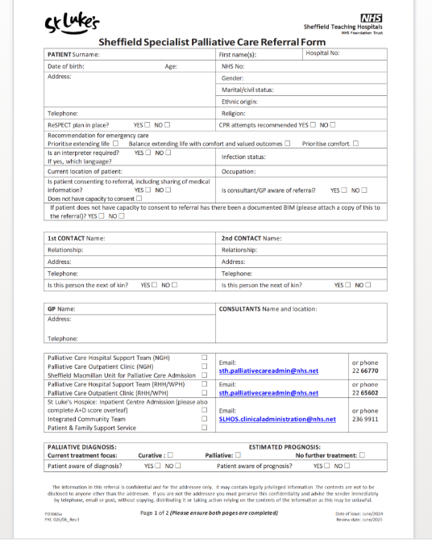
How to refer?
To access our clinical care, patients must be over 18, need a referral from a healthcare professional and a diagnosis of a progressive illness with no known cure. If you feel your patient would benefit from our services, you can make a referral using this form.

Slide 21
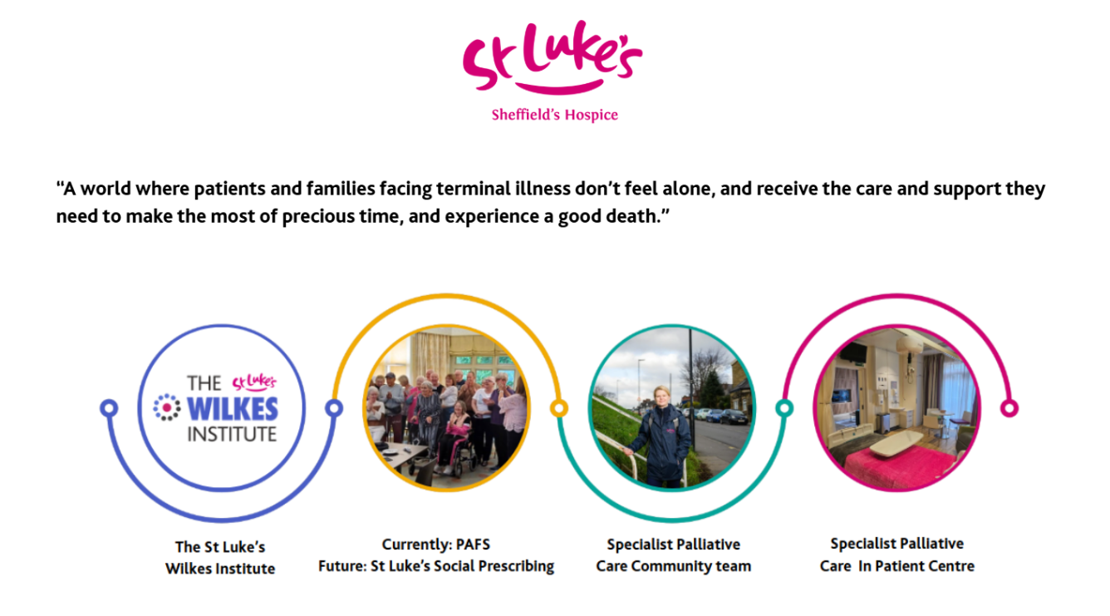
The Wilkes Institute for education and research
St Luke’s- Living well
Integrated community team
In Patient Centre

Slide 22
St Lukes- Living well
Advice from our social prescriber benefits and blue badge | Weekly carers cafe
Chair Pilates | Cooking class
Singing group
Peer support
Integrated community team
Clinic with CNS
Clinic with CNS and Consultant | Counselling joint and singular visits
FAB group
Discharged to primary care team
Integrated community team
Home visits by CNS | Social work review of benefits and POC
Home visit by physio
Inpatient Unit
Short admission (10 days) for pain management
Integrated community team
Home visits by CNS
Death at home
Spiritual team support | Bereavement team
Notes:
We’re not part of the NHS, and we’re completely independent of other hospices.

Slide 23
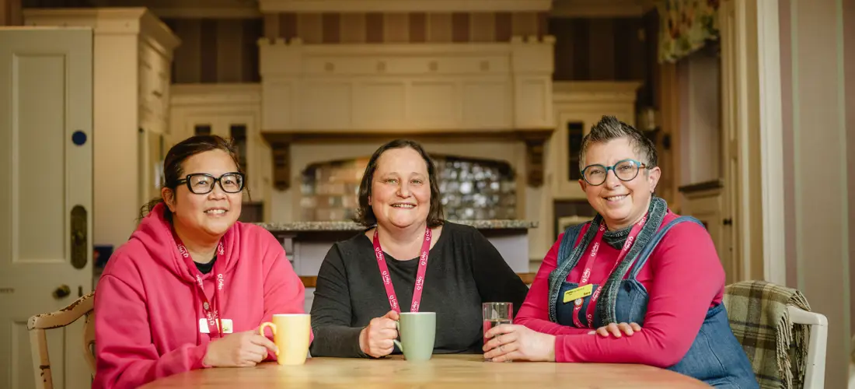
St Luke’s – Living well
Social prescribing offer at our Ecclesall Road South site.
8829 attendances 2025-6
Patients and family/friends, who would meet our referral criteria
Self referral- on our website. Or you can complete a clinician referral
Patients are triaged and we do ask GPs to confirm diagnosis.
3 days a week, specific sessions on Mondays and outreach Fridays.
Weekly carers drop-in sessions Mondays
Run in partnership with the Carers Centre, these sessions offer valuable information about support services, financial guidance, practical skills and more, with the chance to take a break and connect with other carers.
Notes:
Not staffed by clinicians and does do have regulated activity on site.
BUT Celia and Gill do know their clients very well. If they are concerned about they would seek advice and have made referrals to team.

Slide 24

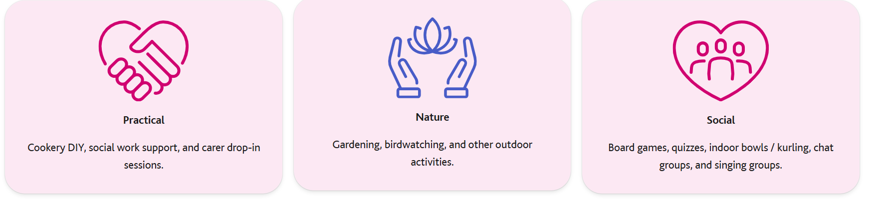
Living Well @ Clifford House Service

Slide 25
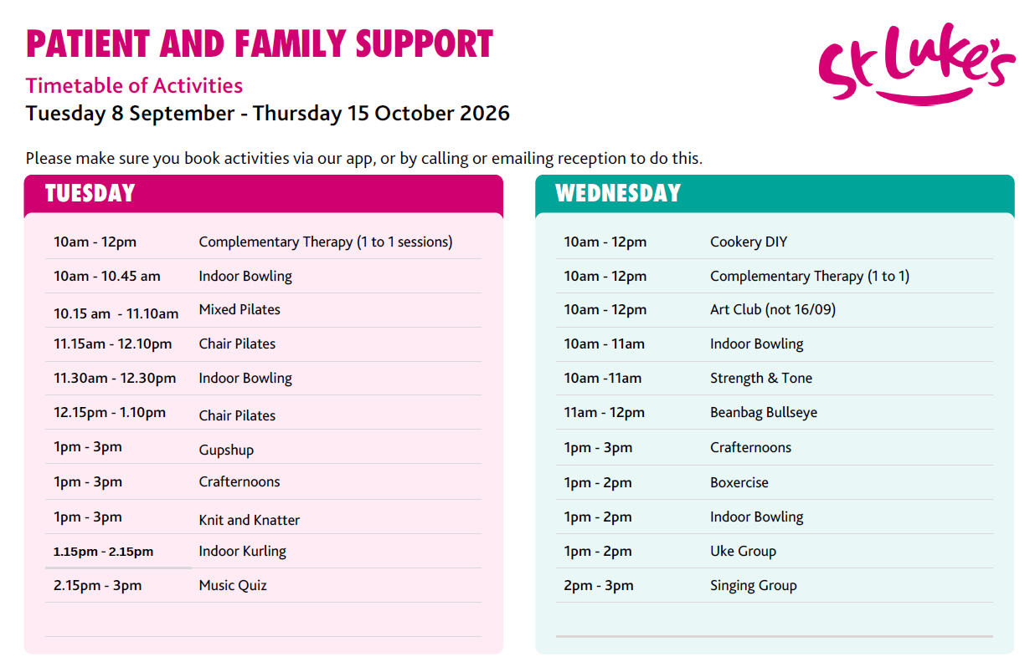

Slide 26






Hubs and Outreach
We currently have 28 active partnerships across Sheffield
We have 1 hub in our retail space at Darnall, this acts as an information sharing and signposting offer, we will be opening a further hub later in the year.
We currently have an outreach offer across a number of areas in the city
-Stocksbridge in the leisure centre
-Jordanthorpe and Batemoor
-Darnall Wellbeing and Hub
-Pitsmoor
Notes:
Living well is getting out to the city.
Darnall shop (info attached) and our art session at Stocksbridge leisure centre at 10.30am on the last Friday of the month.

Slide 27
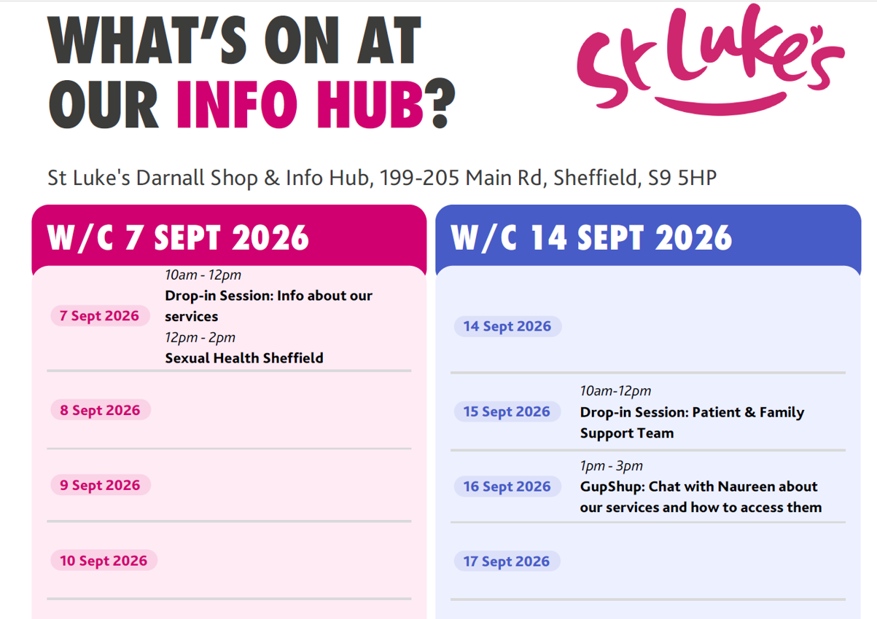
Hubs and Outreach
Darnall Info Hub Timetable_Social Prescribing_Approved_PM_2026
Notes:
Living well is getting out to the city.
Darnall shop (info attached) and our art session at Stocksbridge leisure centre at 10.30am on the last Friday of the month.

Slide 28
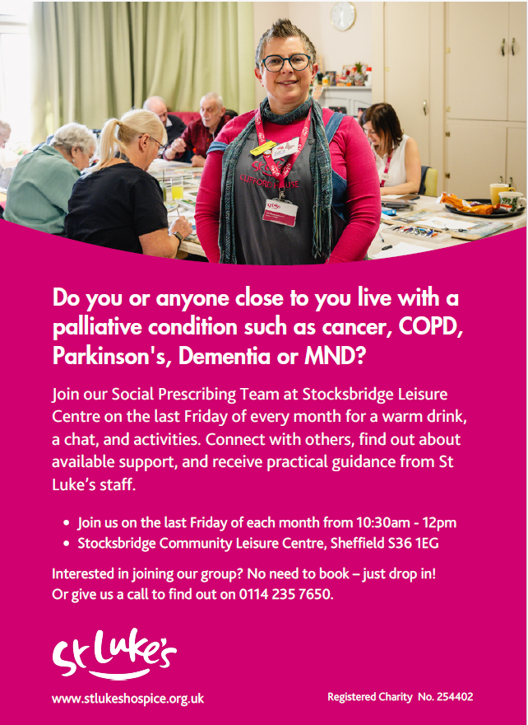
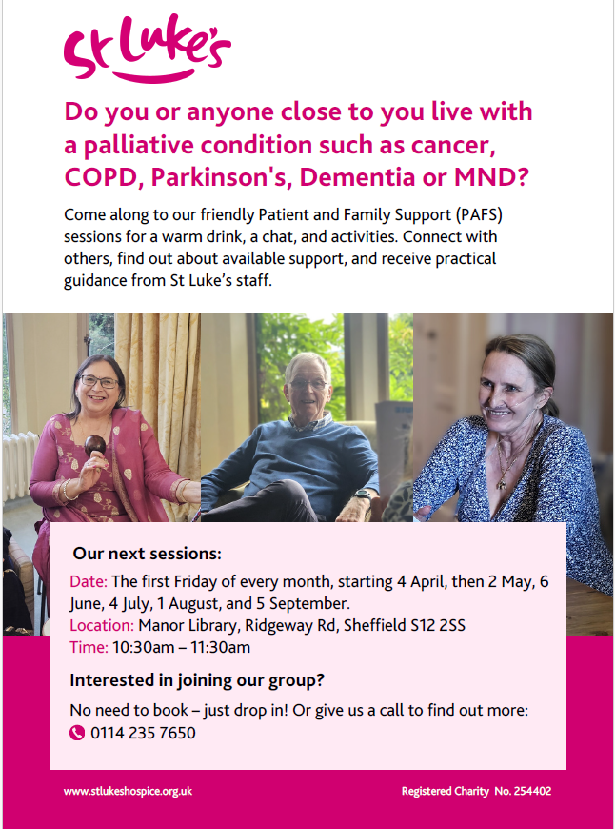

Slide 29
Counselling, pre and post bereavement for adults
Open to patients of St Luke’s and their families/friends.
We don’t accept referrals for patients solely for counselling, but we would refer internally.
Family and friends- can refer themselves
  Counselling
  Psychology as needed
Notes:
We are starting a social enterprise early 2027. Plan is for those people who would not otherwise have access to St Lukes counselling services can access for a fee.
Those who would have usually been supported by us, will still be supported for free. Any monies made will go back into the hospice.

Slide 30
Children’s Bereavement and Art Therapy
St Luke’s Hospice bereavement services extend to children and young people aged 5-16, providing professional counselling, art therapy and support tailored to each individual’s needs, helping them to express their feelings and begin to move forward, to children and young people of patients who are or who have been under our services.
Our service is delivered by qualified counsellors and art therapists, with support from trained volunteers. For children aged 5-7 and 8-11, we offer age-appropriate group sessions, while young people aged 12-16 can access one-to-one counselling or art therapy.
Through creative activities, peer connection and emotional support, children and young people are helped to understand grief, build resilience and explore their emotions in a safe and compassionate space following the loss of their loved one.
Notes:
We are starting a social enterprise early 2027. Plan is for those people who would not otherwise have access to St Lukes counselling s

Slide 31
How to refer?
To access our other support services, including counselling services, as a patient or loved one of a patient, a self-referral form can be completed.
Palliative Counselling | Our Services | St Luke’s – Sheffield’s Hospice
If you have any questions about a referral or getting a patient referred, please call 0114 235 7663

Slide 32
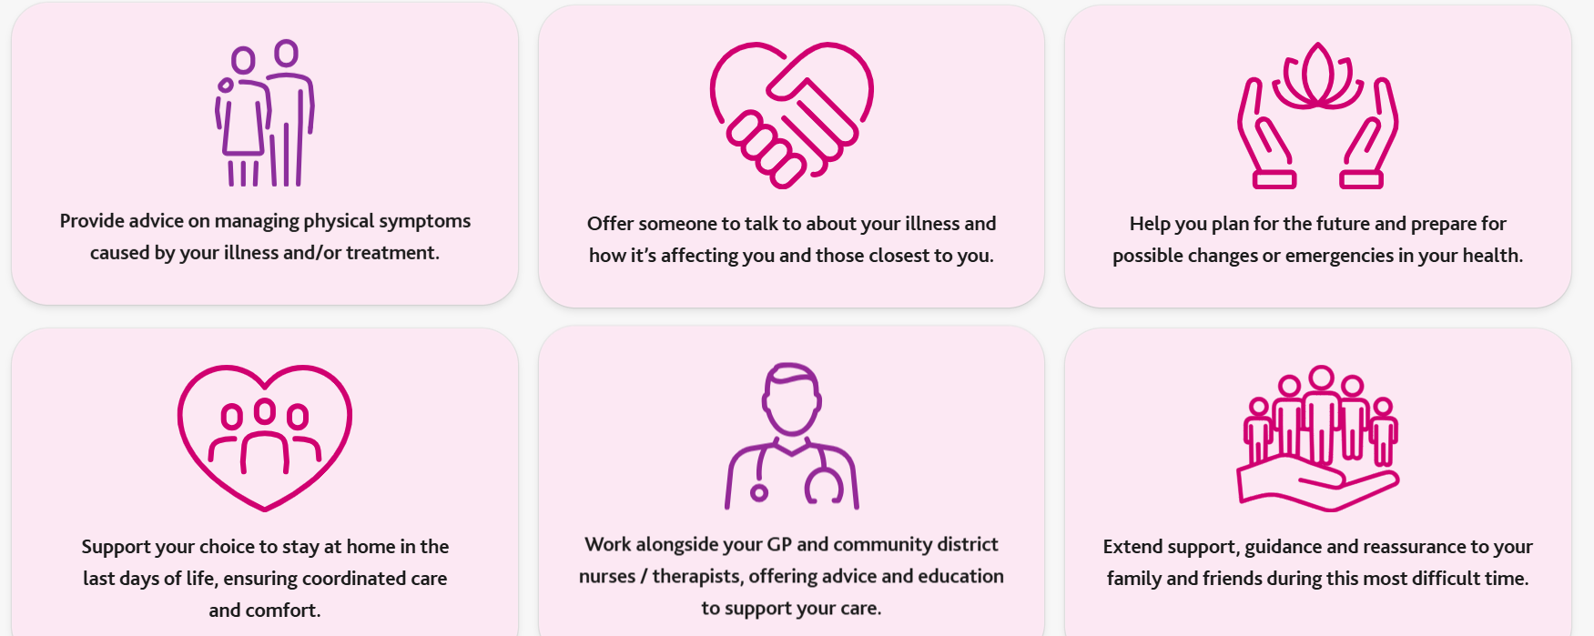
Integrated Community Team-Clinic, Groups and Home visit
Our Community Team brings specialist knowledge and expertise into the community, to support people living with advanced and complex illness in their own homes. Their work includes specialist clinical assessment, advanced symptom management, and specialist interventions and advice, alongside emotional and psychological support - helping people remain as comfortable and well-supported as possible in their own home.
Notes:
Around 1200 patients a year, between 300 and 400 at a time.
Outpatient clinics staff nurse, CNS and consultant.
Physio, OT, Social work, art therapy, spiritual, wellbeing
FAB, therapy through nature, Bathing service. Food service
Nursing and medical visits at home.
Support primary care- not take over.
Don’t always have a prescriber on
Try and see people as quickly as we can but 5 nurses short at the mo so wait times are longer. If you need urgent advice/visits please call. It will go to voice mail we do call back.
Bypass numbers and mobile number- don’t want to call on day off.

Slide 33
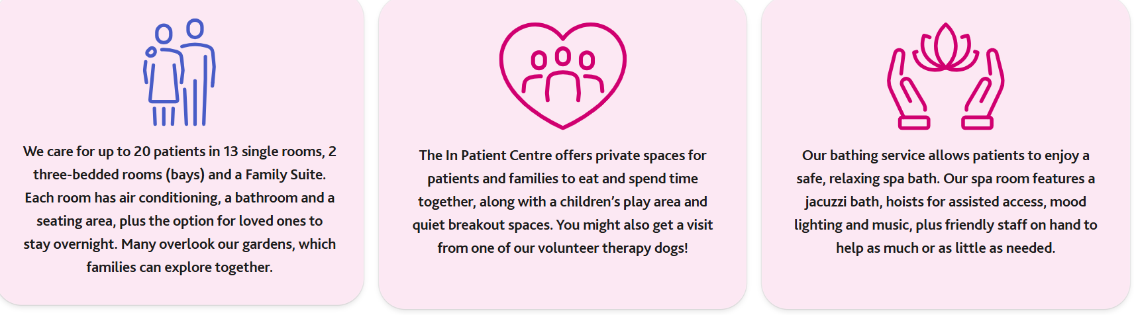
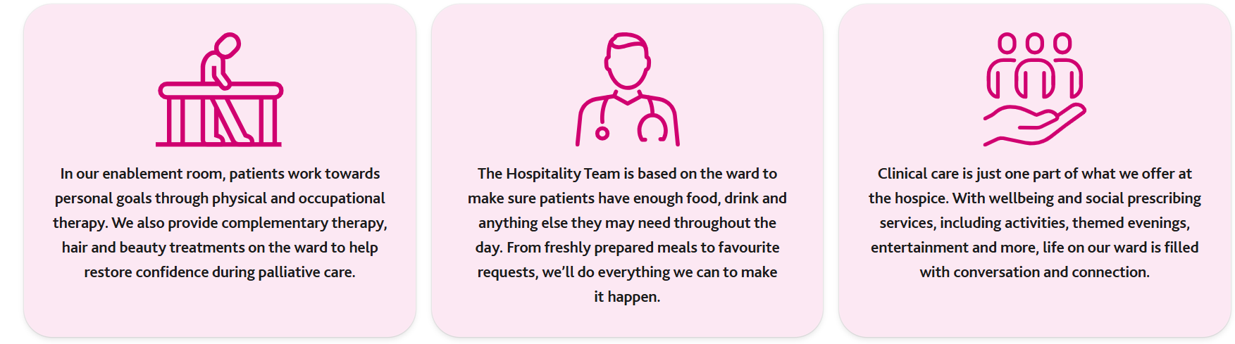
Inpatient Centre including the family suite
Our In-Patient Centre is open 7 days a week, 365 days a year, providing round-the-clock tailored care.
Access to
Notes:
What we can and cant do on the IPC- peg/niv … medical complexity
No respite

Slide 34
“Grey Patients”
Subset of patients who do not fit the traditional palliative care referral criteria and may not best served by a standard ICT referral
Multimorbid but nothing that is strictly palliative
Longer prognosis
Housebound with no or limited access to their secondary care clinicians
Complex medical, legal, ethical or communication situations where you would appreciate a palliative care view
Currently we are happy to talk directly to primary care to consider whether a formal clinical review would be helpful. Can either refer and state it is for a medical consultant or call and we can book a convenient time to discuss.

Slide 35
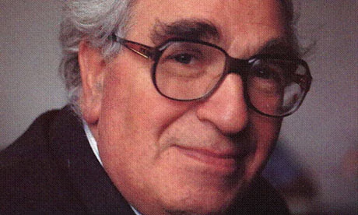
Wilkes Institute
Education, Learning and Training
  “Advance palliative care through learning and collaboration”
Launched in 2026 in memory of our founder Eric Wilkes
Centre to offer education and training in palliative and end of life care
Support our research portfolio and encourage others to research in palliative medicine
The Wilkes Institute | Education at St Luke’s | Palliative Care Courses
Notes:
We’re not part of the NHS, and we’re completely independent of other hospices.

Slide 36
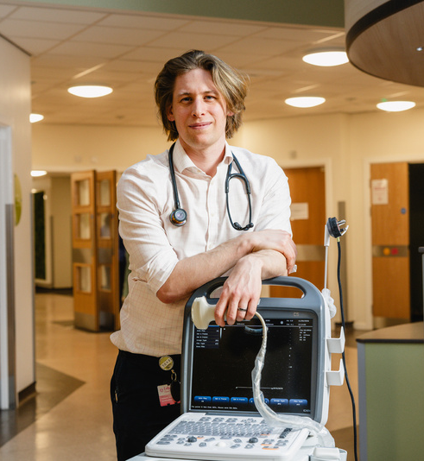
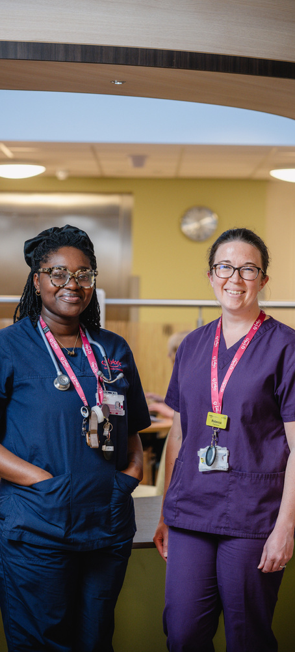
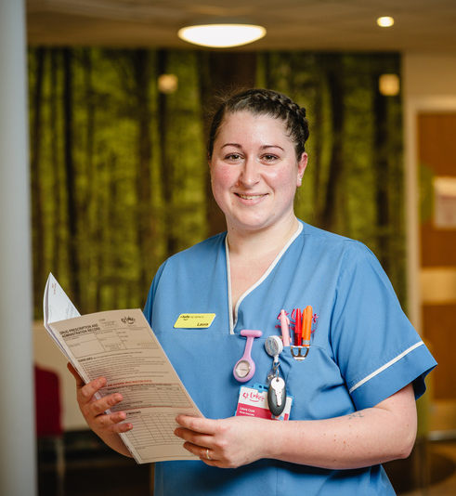
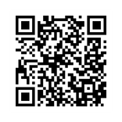
THE
WILKES
AVAILABLE COURSES AND WORKSHOPS
INSTITUTE
Oliver McGowan Tier 2 Mandatory Training
£65pp
Advanced Communication Skills
£500pp
CoMPaSs (Communicating Medicine within Palliative Situations)
£275pp
Complex Needs, Compassionate Care: A Palliative Skills Training Day
£175pp
Dementia Carers Workshops
FREE
Focused Abdominal Sonography in Palliative Care (FASP)
£500pp
Palliative and End of Life Care Education: Transition Simulation Course
FREE
Syringe Driver Training
£30pp
For more information about our courses and to enrol, please visit our website: stlukeshospice.org.uk/wilkes-institute

Slide 37
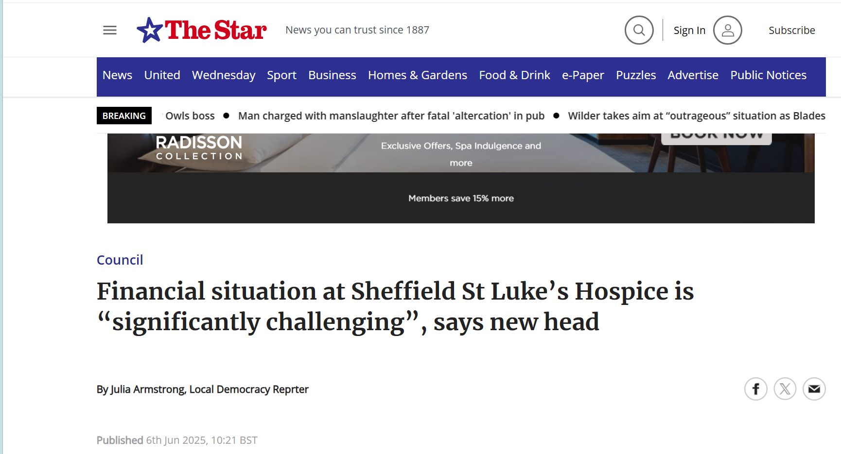

Slide 38
Opportunities for news ways of working
Suggestions for development from our GP colleagues
rapid-access specialist advice
named locality contacts
participation in practice or PCN meetings
opportunities for GP input into future service redesign
Cases model for advice

Slide 39
Opportunities for news ways of working
Specialist palliative overnight telephone helpline
Pilot December 2025-April 2026. Extension to April 2027. Further extension subject to data and resources
Extension of normal working hours 7-day support
Guidance on symptom management, including pain, nausea, and restlessness
Reassurance for carers, especially around medicines or care concerns
Emotional support during times of stress or uncertainty
Signposting to other St Luke’s services, such as Social Work, Wellbeing, Bereavement Support, or Physiotherapy

Slide 40
Contact
  SLHOS.ClinicalAdministration@nhs.net
  Clinical queries- manned 7 days a week, office hours. Will get passed to the appropriate person
  0114 235 7663
  Coordinating nurse in community. Goes to voicemail but manned 7 days a week 9-5
  Out of hours cross city on call via STH switchboard
  H.mcloughlin@hospicesheffield.co.uk
  S.Kyeremateng@hospicesheffield.co.uk

Slide 41
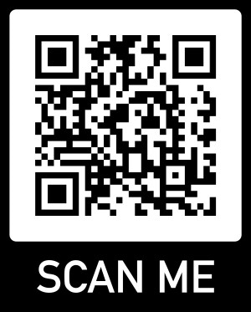
Thank You
Please take a few minutes to complete the post-course evaluation survey

